Slide 1
3D Printing a Spectrograph
Jerrold Foote
Washington, UT
Forrest Sims
Gilbert, AZ
Anthony Rodda
Ponteland, UK
Paul Gerlach
Ultrecht, The Netherlands
Thomas Smith
Weed, NM
Wayne Green
Boulder, CO
Clarke Yeager
Longmont, CO
Robert Buchheim
Phoenix, AZ

Slide 2
The Project
3D Print a Spectrograph with these capabilities:
R=1000 with possible operation at R=10,000
Modifiable for use with f/5 – f/10 optics
Adjustable camera focus
Built in flat and calibration lamps
Remote Operation
Off-the shelf components

Slide 3
The Approach
Start with Paul Gerlach’s LowSpec2
Utilize personal 3D printers
Use on-line tools for collaboration
Hold regular meetings to exchange ideas
Provide a repository for modified parts
Have fun!

Slide 4
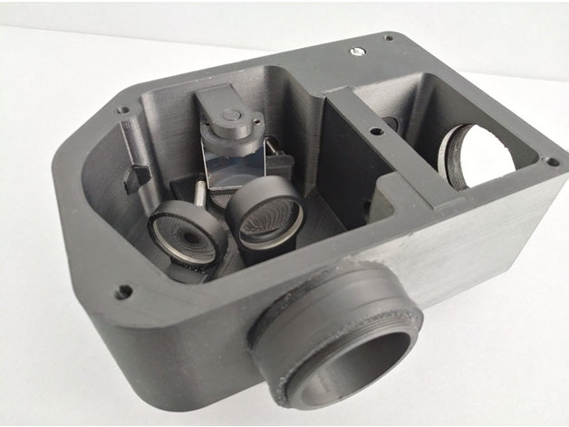
LowSpec2 Optical Layout
Guider Port
Slit Holder
Telescope
Port
Grating
Camera
Lens
Collimating
Lens
Spectra
Camera port

Slide 5
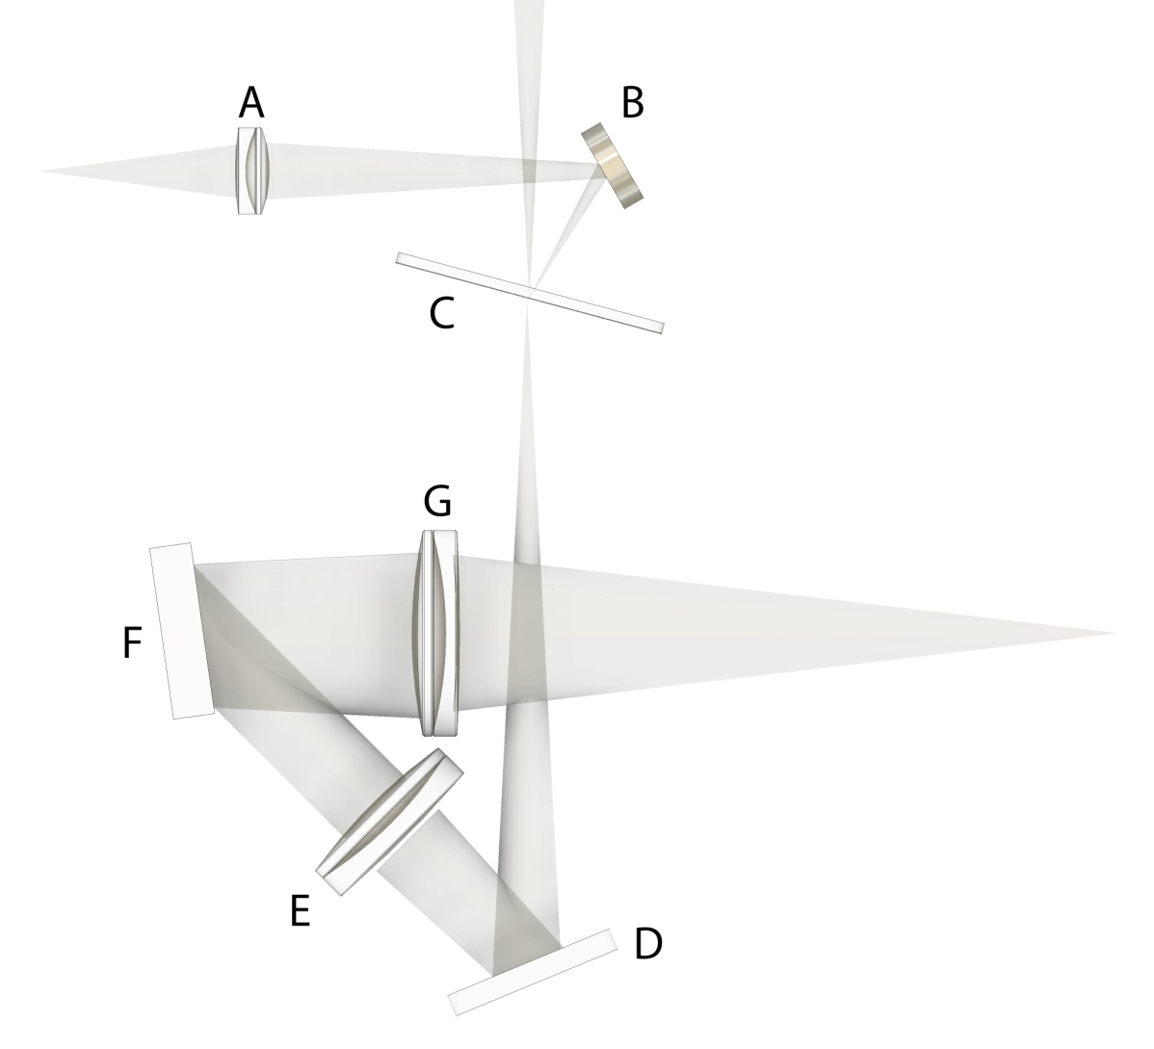
LowSpec2 Optical Layout
A-Autoguider Lens f=30mm
B- Guide mirror
C- Slit wheel
D-Incoming beam mirror
E- Collimator Lens f=125mm
F- Grating
G- Camera Lens f=100mm

Slide 6
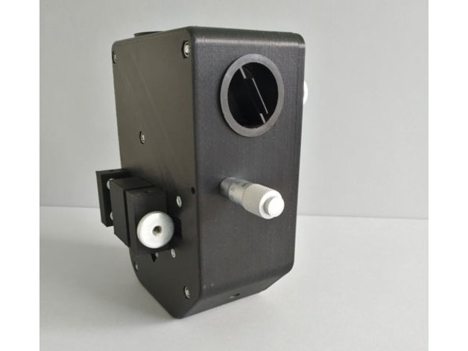
Camera Focus Wavelength Micrometer Guide Camera port

Slide 7
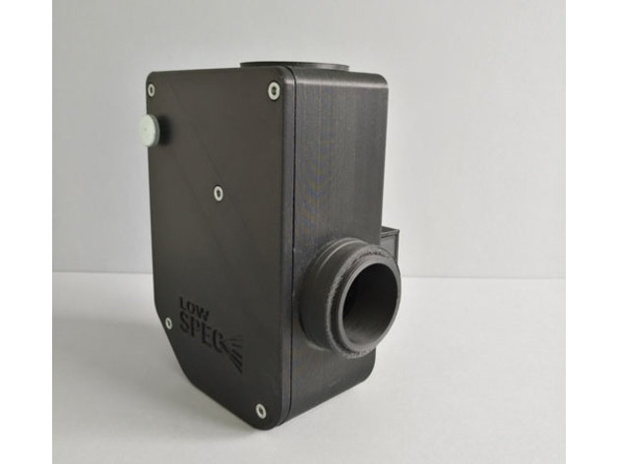
Science Camera Port

Slide 8
The Printers
Relative Inexpensive <$500
Working volume of 200 x 200 x 200mm
0.1mm thick layers with 0.4mm trace width
Use Fused Deposition Modeling Process
Start with PLA and move to better materials

Slide 9
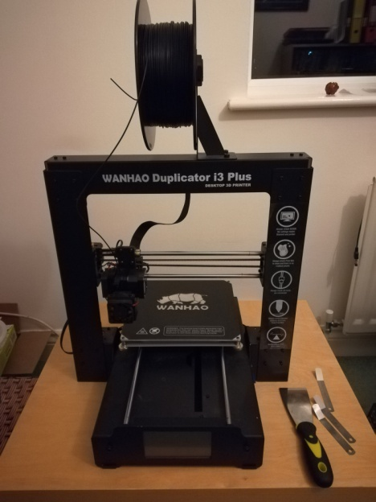
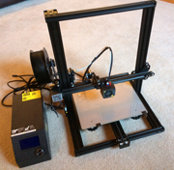
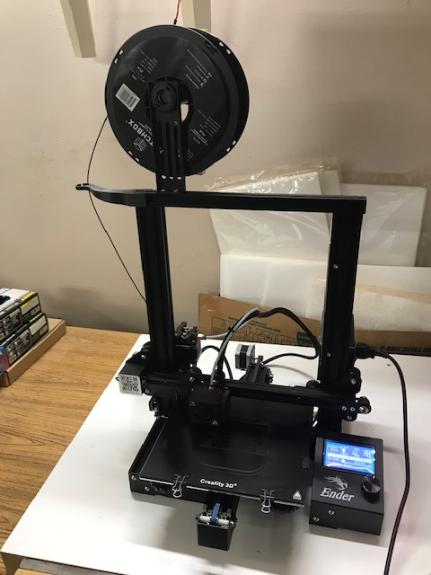
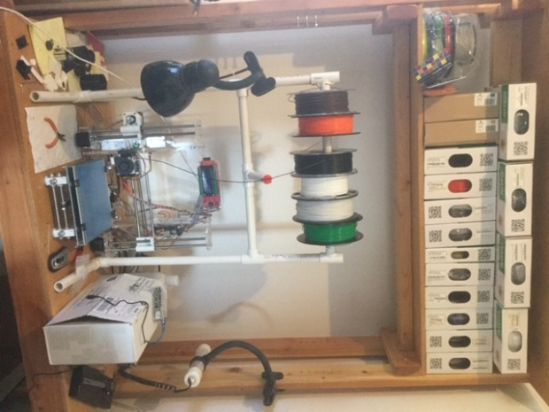
Our Printers
Ender 3 Pro
Wanhao i3 Plus
Home made
Crealty CR10

Slide 10
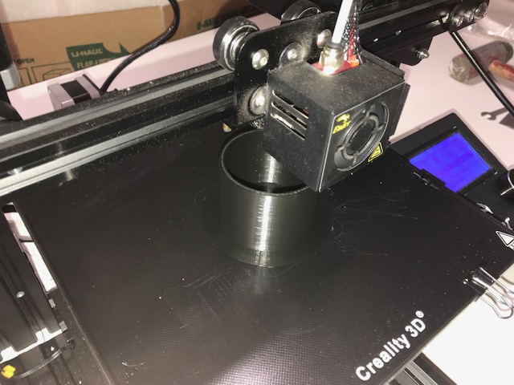
Printing a T2 adapter

Slide 11
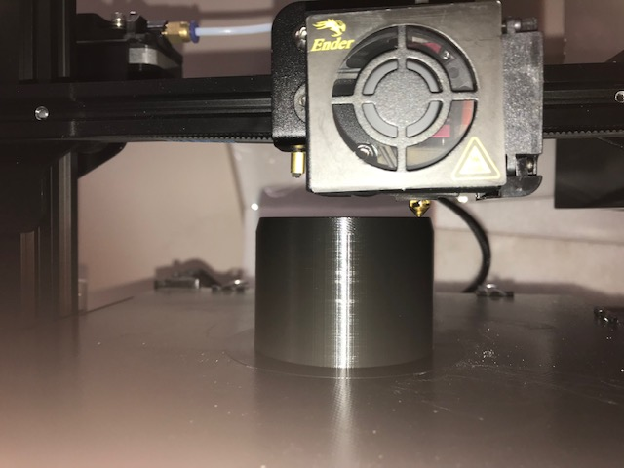
Nozzle Printing a Layer

Slide 12
Process
Design Part
SolidWorks
Fusion 360
TinkerCAD
123DDesign
.STL File
Slice Part
Ultimaker Cura
G- Code
Print Part
Ender 3
Wanhao i3
CR-10

Slide 13
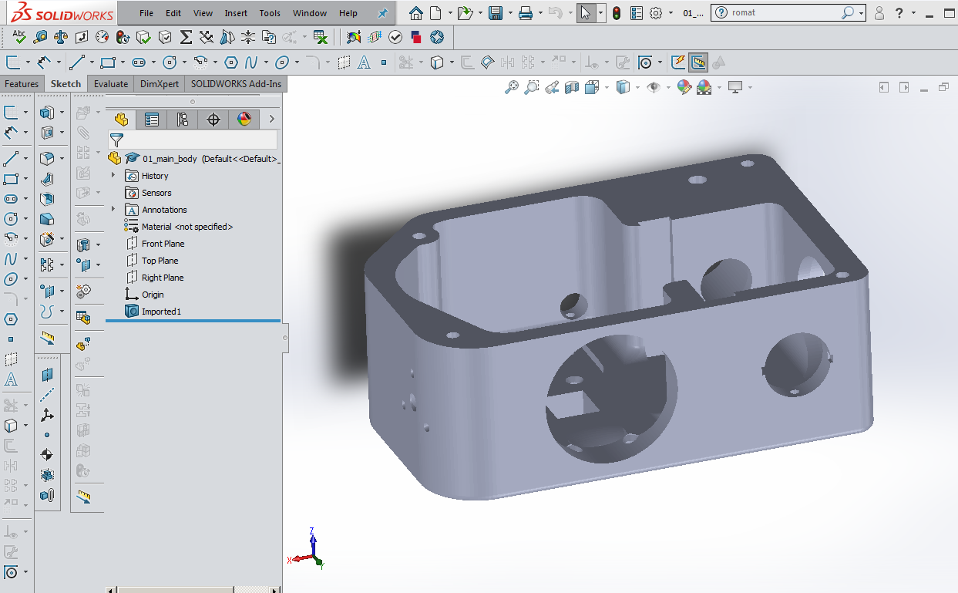
Part Design
SolidWorks (Parametric)

Slide 14
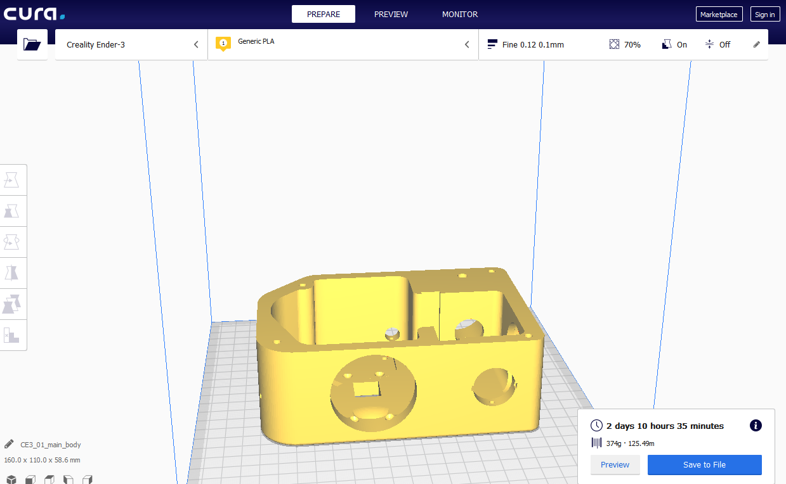
Slicing Software
Cura 4.0
Generate G-Code for printer

Slide 15
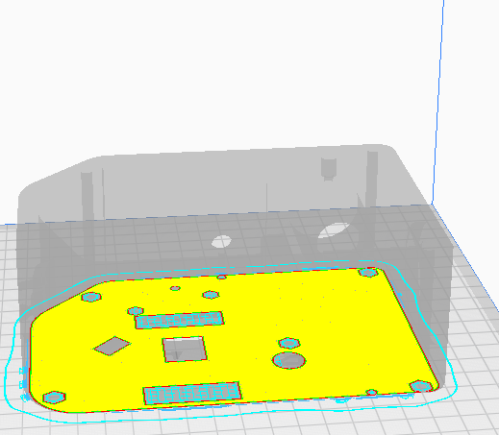
Layer 1 00:00 hr

Slide 16
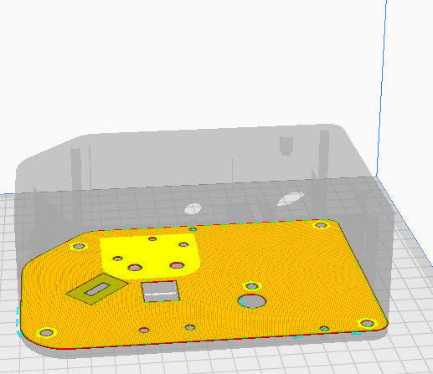
Layer 60 05:54 hr

Slide 17
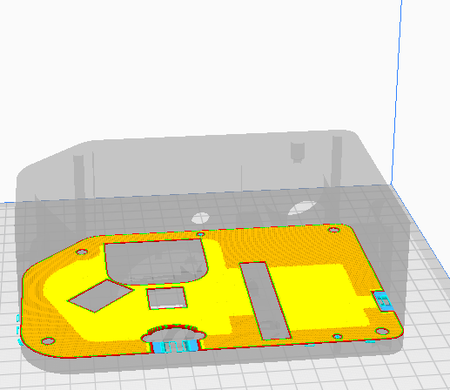
Layer 90 08:54 hr

Slide 18
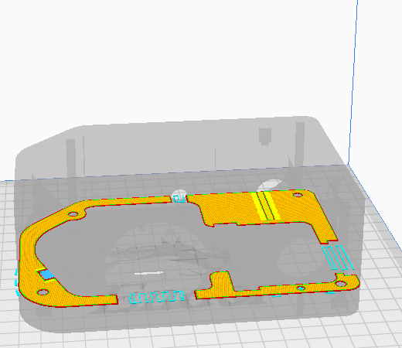
Layer 150 14:48 hr

Slide 19
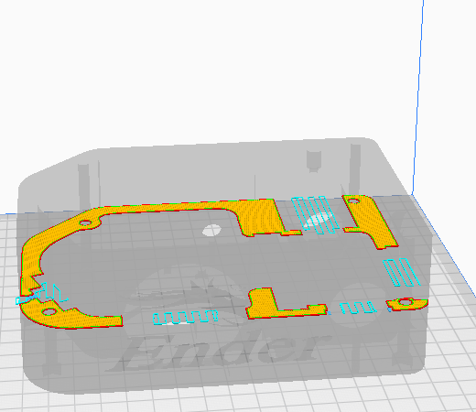
Layer 300 29:49 hr

Slide 20
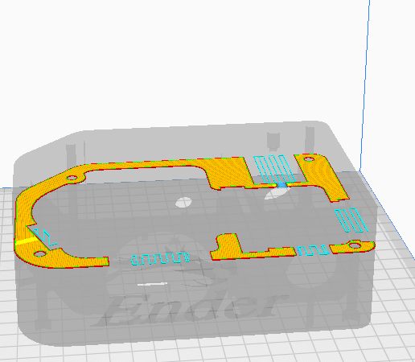
Layer 400 39:27 hr

Slide 21
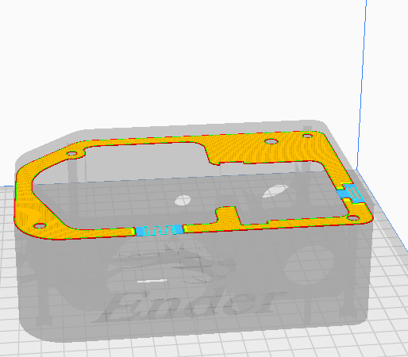
Layer 525 52:01 hr

Slide 22
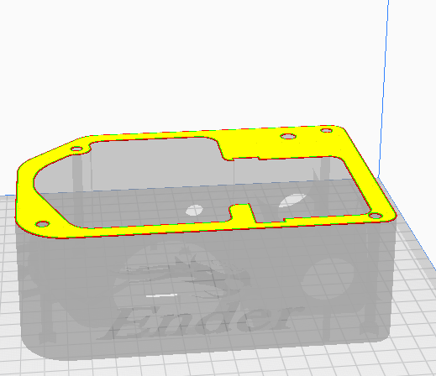
Layer 586 58:00 hr

Slide 23
Design Issues
Thermal Stability
Flexure
Material
Light Tight
Adjustments
Calibration

Slide 24
Thermal Stability > 23°C shift during night
Focus
Guide camera
Science camera
Wavelength

Slide 25
Flexure
Thick sections
Fillets in corners
Close coupling to telescope and cameras
Material

Slide 26
Material
PLA
Easy to print
Low shrinkage
Softens at 55°C
ABS
Good to 90°C
More shrinkage
Not UV resistant
ASA
Stiffer than PLA
UV resistant
More shrinkage
PETG + C
Low shrinkage
UV resistant
High print temp.
Nylon + C
Low thermal expansion
Very stiff
Abrasive printing

Slide 27
Light Tight
Internal reflections
Stray light leaks
Material
Coating

Slide 28
Adjustments
Guide camera focus: Set & Forget
Slit width: 10,20,30,40,50,70,100,
150,200,300,500,700µm
Science camera focus: ±0.1mm, Range 6mm
Center wavelength: 300 – 1800 l/mm

Slide 29
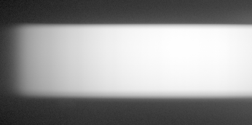
Calibration
Flats – Tungsten lamp
External to telescope
Internal to spectrograph

Slide 30
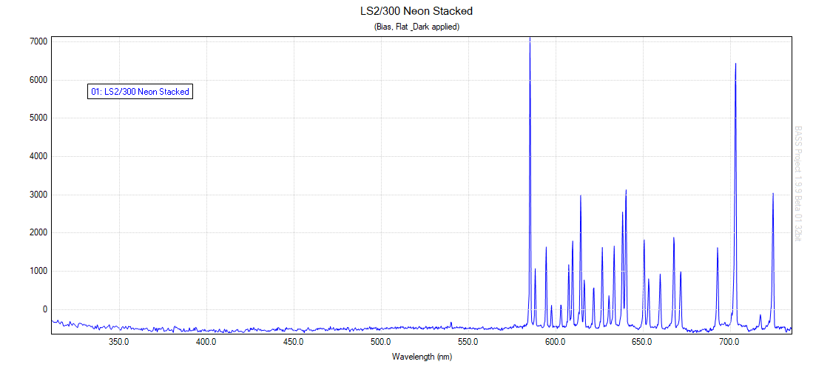
Calibration
Wavelength
Neon

Slide 31
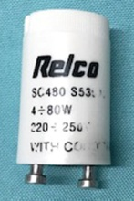
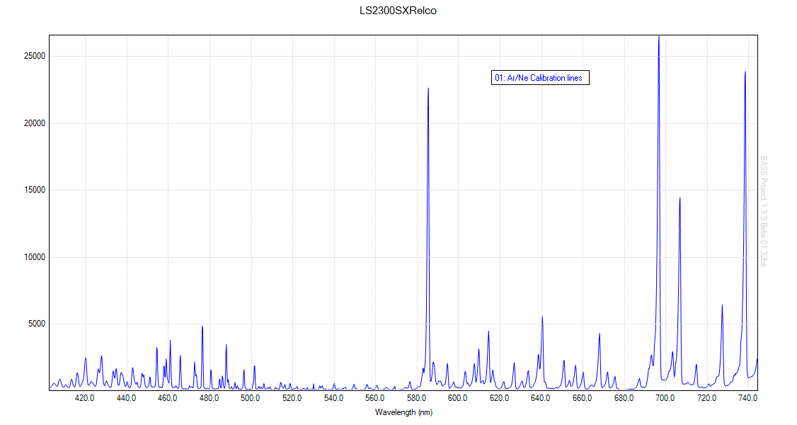
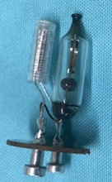
Calibration
Wavelength
“RELCO Starter”

Slide 32
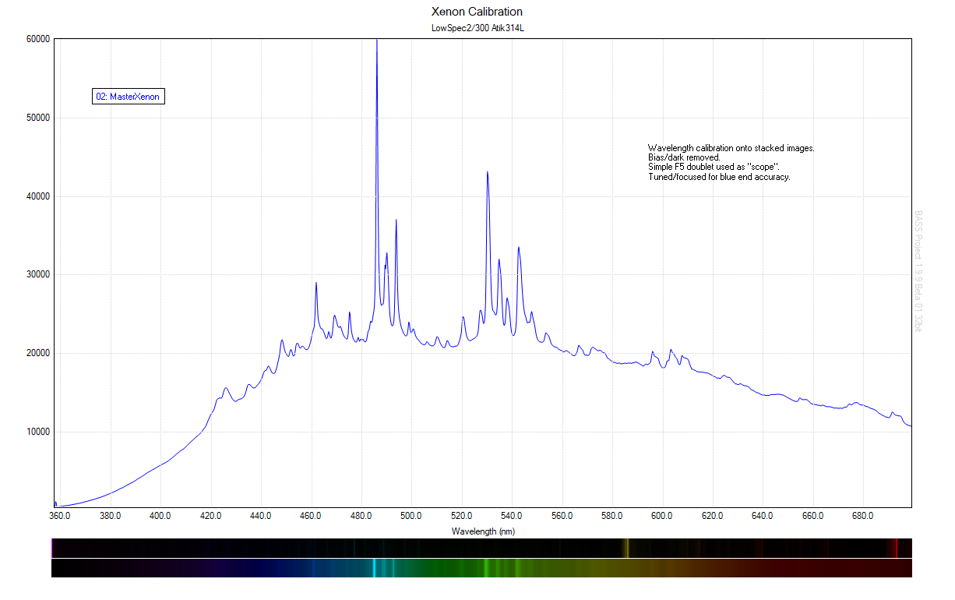
Calibration
Wavelength
Xenon

Slide 33
Focal Ratio Modification
Low resolution mode R ≈1000 : f/5, 300 l/mm
High resolution mode R>10,000 : f/10 1800 l/mm

Slide 34
Remote Operation
Spectrograph rotation (Parallactic Angle)
Motorized science camera focus
Motorized grating tilt
Internal slit illumination
Flat field illumination
Calibration illumination

Slide 35
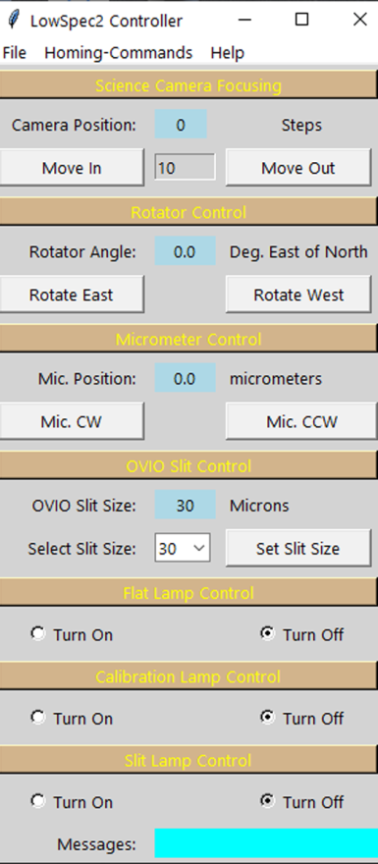
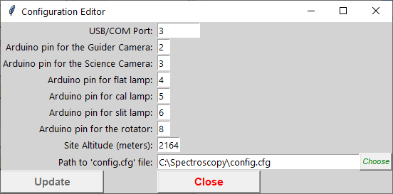
Remote Operation

Slide 36
What can you do with it?
General Classification
Planetary Nebulae
Novae & Supernovae
Seyferts & Quasars
Be Stars
P Cygni Stars
RR Lyra Stars
Miras
T Tauri Stars
Symbiotic Stars
Cataclysmic Stars
Wolf-Rayet Stars
Comets

Slide 37
Future 3D Spectrographs
LowSpec2 improvements
Littrow design: John Pereskeva
Tragos: Tony Rodda/Vadim Burwitz CAOS
Czerny-Turner: Christian Buil

Slide 38
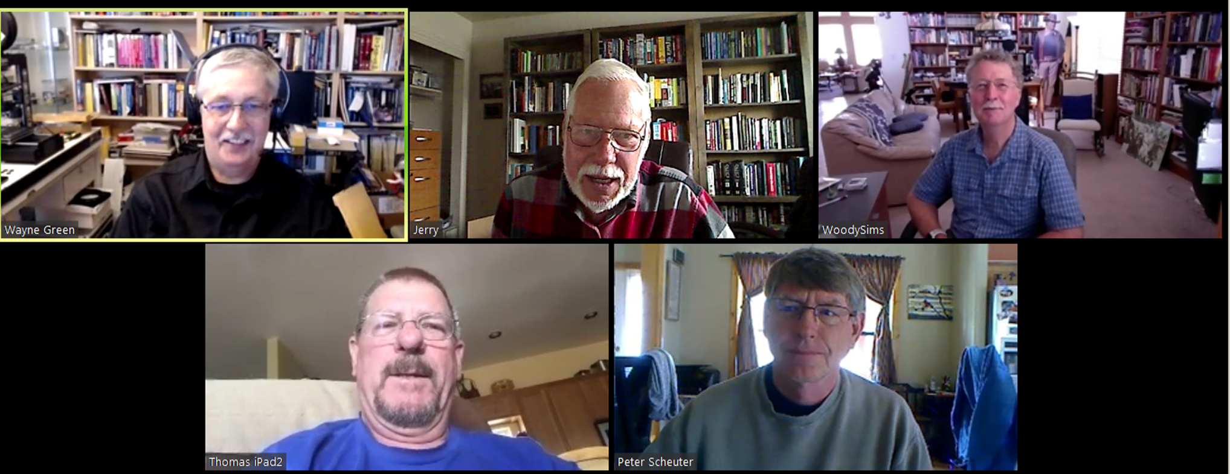
Collaboration
Weekly Video Conferencing – Zoom
Recorded and Saved

Slide 39
Collaboration
Repository – GitHub
Modified parts
Print notes
Projects

Slide 40
Sources
3D printer review and all things 3D https://all3dp.com/
LowSpec2 https://www.thingiverse.com/thing:2455390
Optical Components https://www.thorlabs.com/
Remote operation Arduino : https://www.arduino.cc/
Shelyak Instrumants: https://www.shelyak.com/?lang=en
Zoom: https://zoom.us/
GitHub: https://github.com/
Cochard, Francois (2018) Sucessfully Starting in Astronomical Spectroscopy , France, EDP Sciences
Many more in the Proceedings

Slide 41
Questions

